Slide 1
Credit Card Customer Behavior Analysis
A Data-Driven Insight into Customer Spending Patterns and Risk Behavior
Prepared by: Abubakar Shaibu

Slide 2
Project Objective & Dataset Overview
• Objective: Understand customer purchase behaviors to improve retention and reduce churn.
• Dataset: Credit card transaction dataset (Kaggle: arjunbhasin2013/ccdata).
• Total records: 8,950 customers.
• Key fields: BALANCE, PURCHASES, CASH_ADVANCE, CREDIT_LIMIT, PAYMENTS, TENURE.

Slide 3
Data Preparation Steps
• Handled missing values using median imputation.
• Normalized monetary columns for consistency.
• Created derived features such as:
- Average Monthly Spend
- % of Installment vs One-Off Purchases
- Credit Utilization Rate
• Segmented customers by Tenure, Spending Behavior, and Repayment Patterns.

Slide 4
Exploratory Data Analysis (EDA)
• Identified highest vs lowest spenders.
• Analyzed dominant purchase categories.
• Examined spending vs repayment behavior across tenure.
• Flagged heavy cash advance users (potential financial risk).

Slide 5
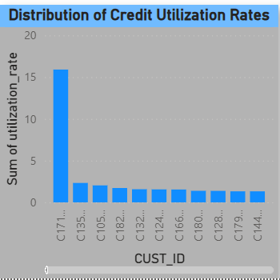
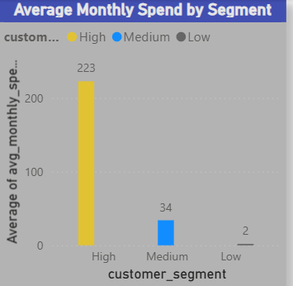
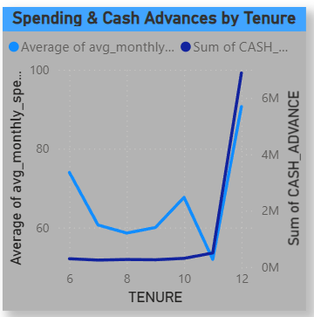
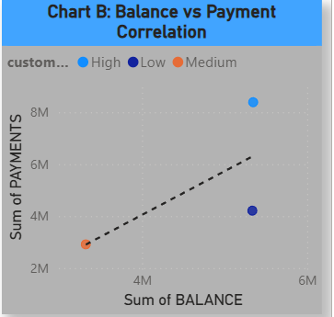
Visualization Highlights

Slide 6
Key Business Insights
• Top 20% of customers contribute to 60% of total purchases.
• Cash advance customers have higher overdue risk and lower repayment ratios.
• New customers (<1 year tenure) spend less but show rapid growth trends.
• Customers with high utilization (>80%) tend to have more volatile balances.

Slide 7
Customer Segment Profiles
• High Spenders: Consistent monthly spend, high repayment rates.
• Occasional Spenders: Irregular purchase patterns, moderate balances.
• Cash-Advance Heavy Users: Low payments, high financial risk.
• New Customers: Growing engagement, opportunity for loyalty programs.

Slide 8
Business Recommendations
• Introduce loyalty campaigns for new and occasional spenders.
• Offer lower interest or credit limit increase for high spenders with good repayment.
• Monitor cash-advance heavy users with risk scoring models.
• Personalize marketing based on segment behavior insights.

Slide 9
Conclusion
This analysis provides data-driven insights to enhance customer retention, optimize campaigns,
and manage credit risk effectively. Power BI dashboards support real-time exploration of key metrics,
enabling informed strategic decisions.

